Slide 1


CSE 446 / 598 Software Integration and Engineering Day One Itinerary About the Course
Dr. Yinong Chen
https://myasucourses.asu.edu/

Slide 2
Day One Itinerary
About the instructor
Course objectives & outcomes
Syllabus discussion
Unit 1

Slide 3
Instructor: Yinong Chen
Joined ASU CSE in 2001
This Semester:
CSE 220 Programming for Computer Engineering
CSE 240 Intro to Programming Languages
CSE 446 / 598 Software Integration and Engineering
Before this semester at ASU
CSE101/FSE100: Every semester from Fall 06 to Fall 11, S16
CSE230: F11, F12, S13, F13, F14
CSE220: S2017, S2017, S2018
CSE 240: F01, S02, F02, S03, F03, S03, SS04, F04, S05, F05, S06, S07, S12, S13, F13, F14, S15, F15, S16, F16, S17, F17, S18
CSE 310: SS01, F01, SS02
CSE 225/EEE225: F02, S03, F03, S04; CSE 330: S02, SS 03 → CSE230 CSE 420/598: S01
CSE 423: (Capstone) S08, F09; CSE485 F15
CSE 445/598: Almost every semester and summer since 2006 CSE 446/598: Every Spring and Summer since 2010.

Slide 4

Yinong Chen
Before joining ASU
Taught for six years Department of Computer Science Wits University of Johannesburg, South Africa
Postdoc at LAAS-CNRS, Toulouse, France
Ph.D. from University of Karlsruhe (KIT), Germany
Contact and more … http://www.public.asu.edu/~ychen10/
Heinrich Hertz worked at KIT from 1885 to 1888, where he discovered electromagnetic waves

Slide 5
Yinong Chen
More than 10 books
200 research papers, 150 of which are after 2005 in service-oriented computing and computer science education
Editor of international journals
Chair of international conferences
Keynote, panel talks
Teach high school students to program robots

Slide 6
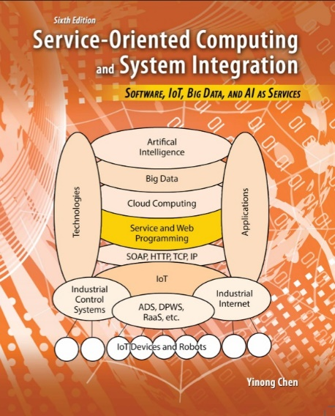
CSE 445 DSD vs. CSE446 SIE
CSE446 Software Integration and Engineering
Catalog Description
Software development using architecture design, composition, workflow, services, data resources, data representations, data management, and development tools.
Co-requisite: CSE445 (Does not apply to CSE598)
Key differences with CSE445
Composition and work flow: architecture-driven software integration from existing components, cloud computing;
Data sources and data management: Integration of computing with large data sources – databases and other data files, big data, and ontologies,

Slide 7
Sections in Spring 2019
CSE446
CSE598
CSE446 in Person
GOEE CSE598 Online
Lectures in Classroom
Mid-Term and Final Exam
in Classroom
Quiz and Unit Test
Online
Assignment
Submission Online
Lectures
Online
Mid-Term and Final Exam
Online

Slide 8
Objectives and Outcomes
1. To understand software architecture and software process
Students understand the requirement and specification process in problem solving.
Students understand software life cycle and process management
Students can identify advantages and disadvantages of software architectures and their trade-offs in different applications
Standard objective and outcomes in any software engineering course

Slide 9
Objectives and Outcomes
2. To understand and apply composition approach in software development
Students can apply software architecture to guide software development in the problem solving process.
Students understand interface requirement of software services
Students can compose software based on interfaces of services and components
Students can develop software system using different composition methods and tools

Slide 10
Objectives and Outcomes
3. To understand and apply data and information integration in software development
Students can compose software systems using different data resources in different data formats.
Students can integrate application logic with different databases.
Students can apply the entire software life cycle to develop working software systems.

Slide 11
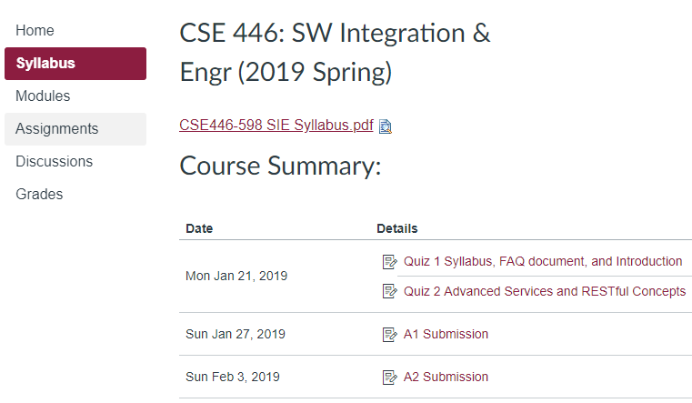
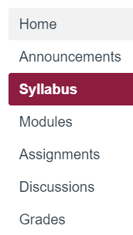
Canvas: Syllabus and Course Summary

Slide 12
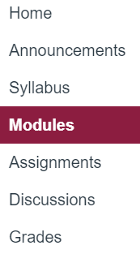
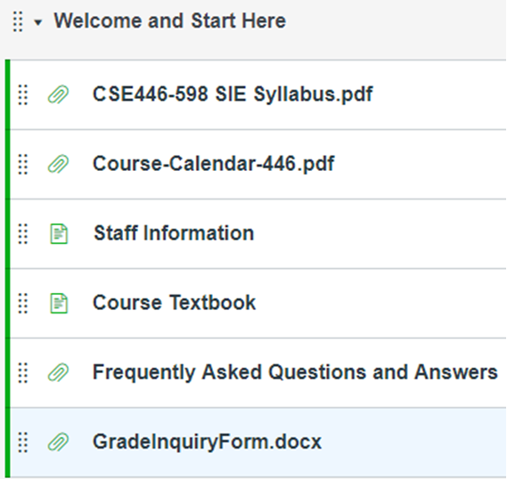
Canvas: Modules and Course Information

Slide 13
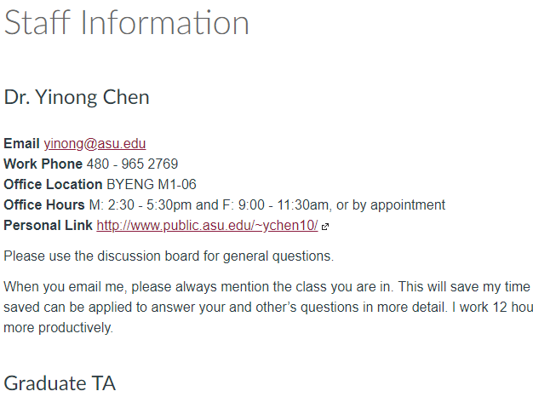
Canvas Course Modules: Staff Information
Name, contact, and office hours will be announced

Slide 14
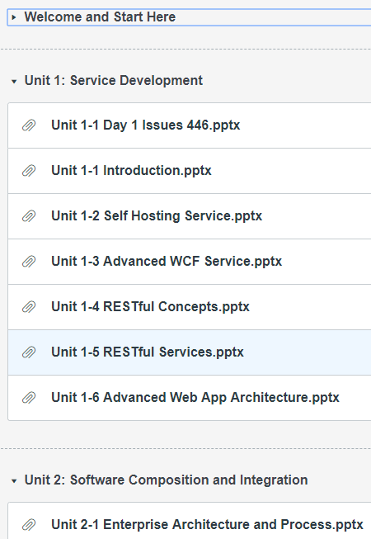
Canvas: Modules and Lecture Slides

Slide 15
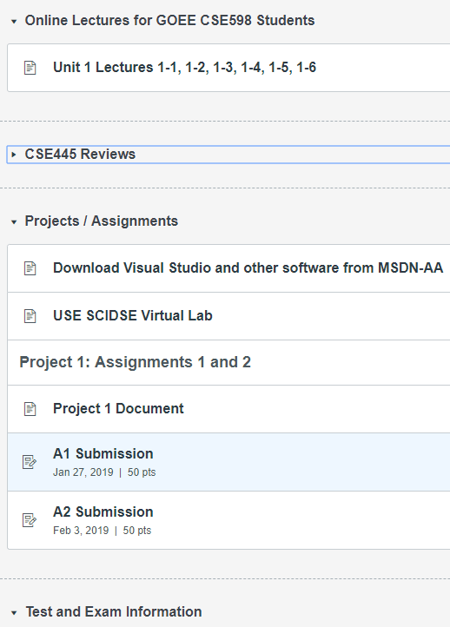
Canvas: Modules and Lecture Slides

Slide 16
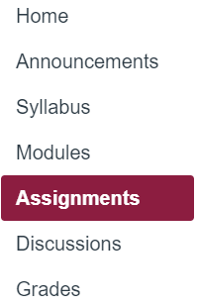
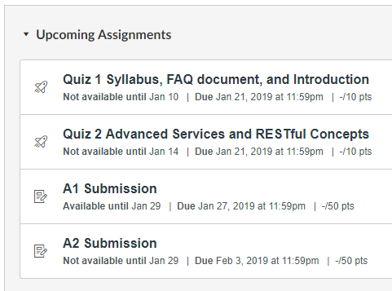
Canvas: Upcoming Tests and Submissions

Slide 17
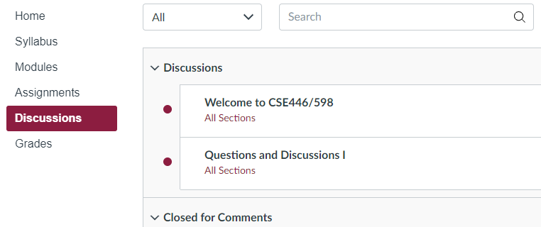
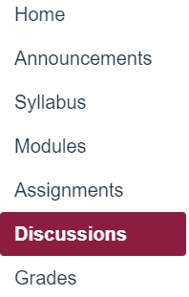
Canvas: Discussion Board

Slide 18
Weight and Grading Scale
Quizzes and unit tests will be given online for all students. You can take them in the lecture week.
Percentage | Symbol Grade
96.5-100% 92.5-96.4% 89.5-92.4% | A+ A A-
86.5-89.4% 82.5-86.4% 79.5-82.4% | B+ B B-
75.5-79.4% 69.5-75.4% | C+ C
59.5-69.4% | D
Below 60% | E
Graded Activity | Weight
Projects/Assignments | 30%
Weekly Quizzes* | 11%
Unit Tests 1, 2, 3, 4, 5^ | 12%
Mid-Term Exam | 22%
Final Exam | 25%
* The lowest two will be dropped, no make up and no reset
^ The lowest one will be dropped, no make up and no reset.

Slide 19

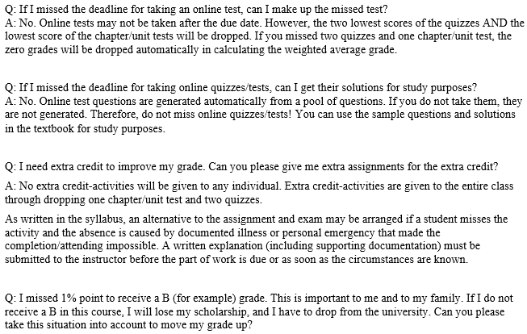
Read FAQ document in Course Web

Slide 20
Standard Classroom Expectation
Silent your cellular phone; If your phone happens to ring, stop it immediately and do not answer your phone!
Use computer for directly related activities only, e.g., taking notes. No computer is allowed during any tests (lecture exercises quizzes, exams).
Do not talk to each other during the lecture. If you have a question that needs to be resolved immediately, you must ask the instructor.
Enter the classroom before the lecture’s starting time.
Do not leave the classroom during the lecture, unless there is an emergency situation.

Slide 21
Policies
Interaction: You are encouraged to ask the instructor questions during the lectures.
Outside class help welcome and encouraged:
Discussion board (effective and fair);
Instructor’s and the TA’s office hours;
Request appointments if you can not make the office hours;
Email/phone call, if necessary.
Tests and exams: Missing tests and exams will be giving zero credit and may not be made up.
Assignments: Late submission will be accepted with grade deduction: 1% of grade deduction for every hour after the due time.

Slide 22
Extra credit, alternative, and inquires
No extra credit-activities will be given to any individual. Extra credit-activities may be given to the entire class.
An alternative to a graded activity may be arranged if a student's absence is caused by documented illness or personal emergency. A written explanation (including supporting documentation) must be submitted to the instructor before the part of work is due or as soon as the circumstances are known.
Any inquires or appeals on grades of homework, projects, or tests must be done in writing by completing the "Grade Inquiry Form" within a week from the day the grades and/or comments were published on-line. State the problem and the rationale for any change in grade in your appeal

Slide 23
Cooperation and Code of Conduct
You are encouraged to cooperate in study group on learning the course materials.
You may not cooperate on preparing the individual assignments. Anything you turn in must be your own work. If you use an idea that is found in a book or other sources, make sure you acknowledge the source and/or the names of the persons in the write-up for each problem.
All assignment questions must be asked in the course discussion board. Asking assignment questions or making your assignment available in the public websites before the assignment due will be considered cheating.
The instructor and the TA are required to CAREFULLY check any possible proliferation or plagiarism. We will use the software tools like MOSS (Measure Of Software Similarity) to check any assignment. The university expects all students to adhere to ASU's policy on Academic Dishonesty. These policies can be found in the Code of Student Conduct:
https://provost.asu.edu/academicintegrity/policy
ALL cases of cheating or plagiarism will be handed to the Dean's office. Penalties include a failing grade in the class, a note on your official transcript that shows you were punished for cheating.

Slide 24
Announcement and Information
Official announcements will be made either in the class or in the “Announcement” part of the course web page.
Articles or answers in the discussion board by the instructor, the TA, or other students are not official announcement.
Make sure you regularly (at least once every two days) check the course web page for any announcements.

Slide 25
CSE 445/598 (DSD) vs. CSE446/598 (SIE)
CSE446/598
Software Integration and Engineering
CSE 445/598
Distributed Software Development

Slide 26

One Text for Two Courses
Part I Distributed Service-Oriented Software Development and Web Data Management
Chapter 1 Introduction to Distributed Service-Oriented Computing
Chapter 2 Distributed Computing with Multithreading
Chapter 3 Essentials in Service-Oriented Software Development
Chapter 4 XML and Web Data Formats
Chapter 5 Web Application and Data Management
Chapter 6 Dependability of Service-Oriented Software
Part II Advanced Service-Oriented Computing and Large System Composition
Chapter 7 Service-Oriented and REST Architecture
Chapter 8 Enterprise Software Development and Integration
Chapter 9 IoT, Robotics, and Device Integration via Visual Programming
Chapter 10 Interfacing Service-Oriented Software with Database
Chapter 11 Big Data, Artificial Intelligence, and Cloud Computing
DSD
Reading
Assignment 1
SIE

Slide 27
Topics To be Covered
Unit 1 - Chapter 7: Introduction, Advanced SOA and REST Architecture
Unit 2 - Chapters 7 and 8: Software Development by Composition and Integration
Unit 3 - Chapter 9: IoT, Robotics, and Device Integration
Unit 4 - Chapter 10: Web Application and Data Integration
Unit 5 - Chapters 11: Big Data and Ontology, AI, Cloud Computing and Software as a Service

Slide 28
Unit 1
Advance SOA and REST Architecture
Day 1 Issues and Introduction
Self-Hosting Services
Advanced WCF Services
REST Concepts
RESTful Services
Advanced Web Application Architecture

Slide 29
Unit 2
Software Development by Composition and Integration
Enterprise Application Architecture
Workflow-based Software Development 1
Workflow-based Software Development 2
BPEL Process
BPEL Case Study
BPEL Frameworks
Message-Based Integration
Other Composition Languages

Slide 30
Unit 3
Event-Driven Development and Device Integration
Device Integration
Internet of Things
Service-Oriented Robotics Computing
Event-Driven Robotics Applications
Robot as a Service in Cloud Computing
Different Visual Programming Languages
ASU VIPLE and Workflow-based IoT App Development
Developing IoT and Service-Oriented Robotics Applications
Finite State Machine and VIPLE Diagram
VIPLE Workflow on different Platforms (Intel and EV3)

Slide 31
Unit 4
Application and Data Integration
ADO
XML Database
LINQ 1
LINQ 2
LINQ 3

Slide 32
Unit 5 Big Data, AI and Cloud Computing
Big Data Concepts and Domains
Concepts
Infrastructure
Big Data Processing
MapReduce and Hadoop
Analytics
AI and Machine Learning
AI Development and Domains
Automation vs. machine-learning software
Case Study: Image recognition
Case Study: Flight pattern training and recognition

Slide 33
Unit 5 (Contd.)
4 Ontology for AI and Semantic Web
Ontology Languages RDF and RDF Schema
Web Ontology Languages and IDEs
5 Cloud Computing and Software as a Service
Software as a Service, Platform as a Service, and Infrastructure as a Service,
Multi-tenancy
6 Cloud Computing Case Studies
Google Cloud: from concepts to implementation
Microsoft Azure from development to deployment
Oracle Cloud
Amazon Cloud

